Slide 1
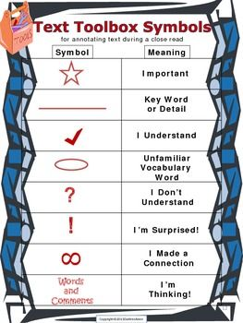
Close Reading Guidelines
Use this text toolbox to pull apart your document.
Anytime you write a symbol on your document, you need to draw a line out into the margin and write WHY you put that symbol there.
Example:
Dark spruce forest frowned on either side of the frozen waterway. The trees had been stripped by a recent wind of their white covering of frost, and they seemed to lean toward each other, black and ominous, in the fading light. A vast silence reigned over the land. The land itself was a desolation, lifeless, without movement, so lone and cold that the spirit of it was not even that of sadness.
Excerpt from White Fang by Jack London

